Slide 1

How we use it
Inspections, repairs, and service — one place for the yard.
For the crew

Slide 2
START HERE
What Walkaround is for
Operators walk a unit and mark the inspection.
A problem becomes a work request for the shop.
Finished inspections and completed work stay in Records.
Walkaround
2 / 13

Slide 3
PEOPLE
Who does what
Operator — inspects the units pinned to them and can request work.
Shop — sees the Shop tab and closes service and repairs.
Supervisor and Admin — set up people, units, and intervals. Admin can delete.
Walkaround
3 / 13

Slide 4
FIRST PHONE
The admin sets up the yard
Open the app. Tap Set my PIN. Enter a 4-digit PIN twice.
Make a recovery word. This is not a PIN. Write it down.
The app shows a yard code. Crew members need that code.
Walkaround
4 / 13

Slide 5
NEW PHONE
How a crew member joins
On the welcome screen, tap Crew members start here.
Enter the yard code from the admin.
Pick your name, then enter the PIN the admin gave you.
Walkaround
5 / 13

Slide 6
EVERY DAY
Home
The counts show units that are out of service and inspections that are due.
Pinned units are the ones assigned to you. Pin a unit from its page.
Suggest a change is at the bottom. Only the admin can read those notes.
Walkaround
6 / 13

Slide 7
THE YARD
Units
Units are in groups, such as trucks, heavy equipment, and small equipment.
Open a unit to inspect it, request work, or pin it to your home screen.
Color on the group makes units easier to tell apart.
Walkaround
7 / 13

Slide 8
THE WALK
Do an inspection
Enter the miles or hours. The inspection will not finish without them.
Mark every item Pass, Fail, or N/A.
A comment at the bottom is optional. Then tap Submit.
Only one person can have an inspection open on that unit. Finish it now.
Walkaround
8 / 13

Slide 9
IF IT FAILS
A fail locks the unit
Any failed item marks the unit out of service.
A work request opens for the shop from that failed item.
You can still inspect it again and request more work.
Walkaround
9 / 13

Slide 10
NEED A FIX
Request work
From the unit, choose Repair, Maintenance, or Safety.
Set a priority. Write a short description. A photo is optional.
That request shows in Shop under Work requested.
Walkaround
10 / 13

Slide 11
THE SHOP
Shop has two lists
Service due — planned service, including one the admin forced early.
Work requested — repairs and problems from the yard.
The mechanic fills the service list, then submits. Their name and the date are saved.
Walkaround
11 / 13

Slide 12
AFTER IT IS DONE
Records
Finished inspections and completed shop work leave Shop and stay in Records.
Supervisors and the admin can open an inspection and print it.
Only the admin can delete a unit, an inspection, or a finished work order.
Walkaround
12 / 13

Slide 13
KEEP THIS
A few rules
Do not share your PIN. If the admin forgets it, the recovery word sets a new one.
Intervals are set by a supervisor. Operators do not change them.
A wiped phone comes back with the yard code and the recovery word.
Walkaround
13 / 13

Slide 14
Walk the yard
before it rolls.
effulgent-sunburst-6263b1.netlify.app
Add it to the home screen so it opens like an app.

Slide 15
IPHONE
Add it to the home screen
1
Open the link in Safari. Do not use Chrome.
2
Tap Share. It is the square with an arrow pointing up.
3
Scroll down and tap Add to Home Screen.
4
Tap Add, then open Walkaround from the new icon.
Walkaround

Slide 16
ANDROID
Add it to the home screen
1
Open the link in Chrome.
2
Tap the three dots in the top right.
3
Tap Install app. If it is not there, tap Add to Home screen.
4
Tap Install or Add, then open Walkaround from the new icon.
Walkaround

Slide 17
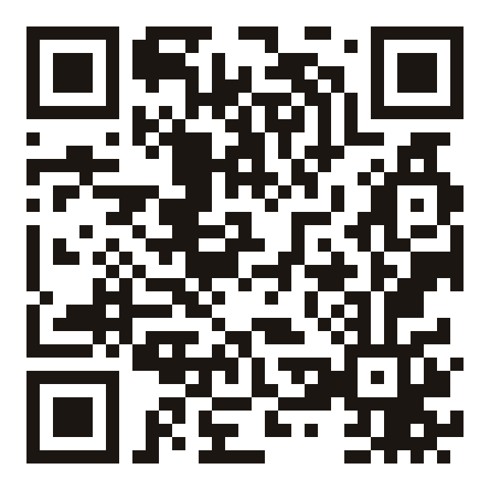
THE LINK
Scan this to open Walkaround
Leave this slide up so the crew can scan it.
iPhone: use Safari.
Android: use Chrome.
Then follow the steps on the previous slides.
effulgent-sunburst-6263b1.netlify.app
Walkaround

Slide 18
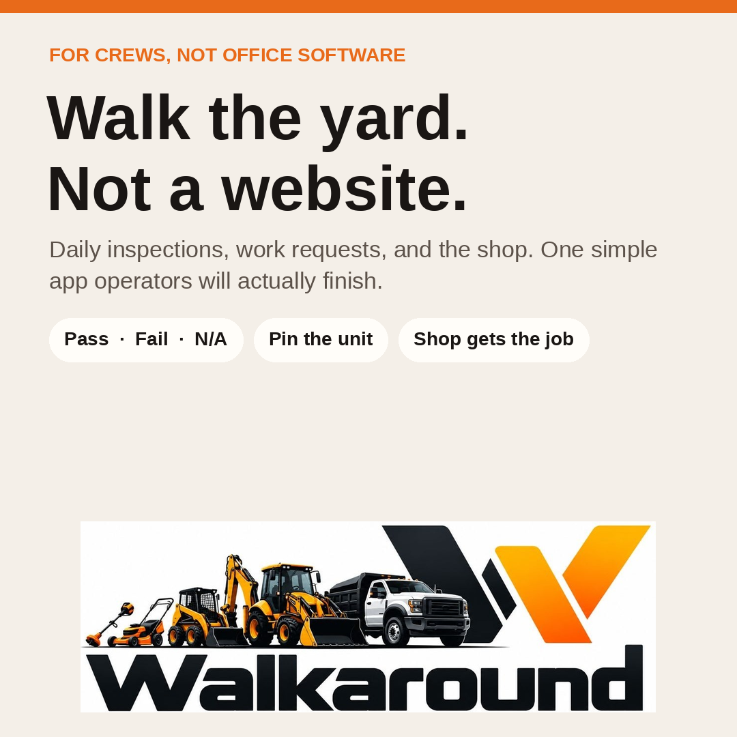
PROMO
Feed post

Slide 19
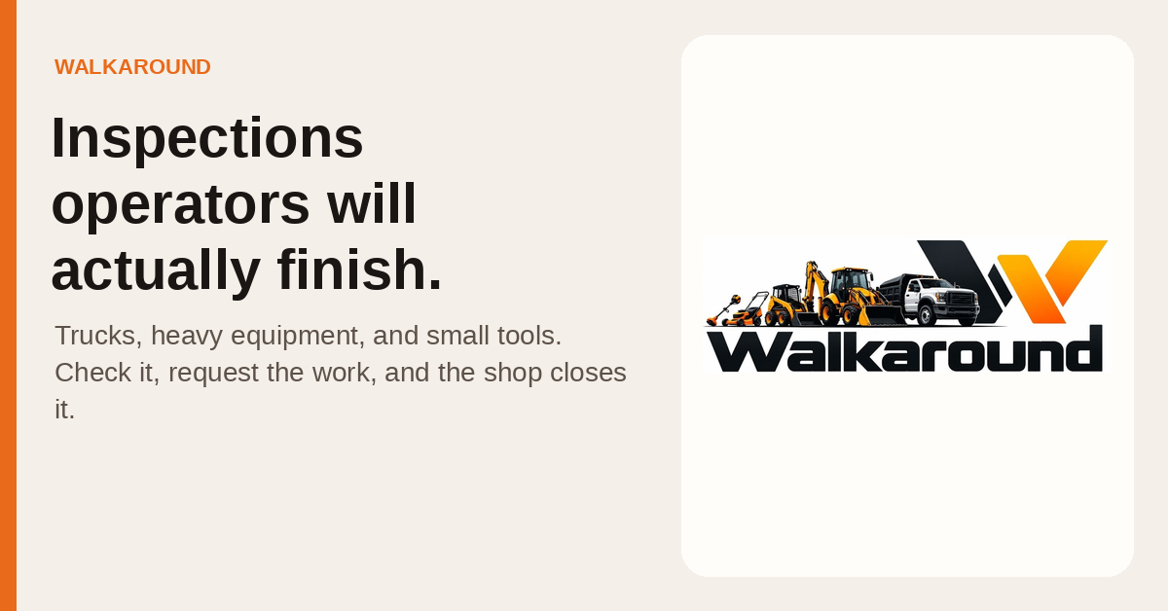
PROMO
Banner

Slide 20
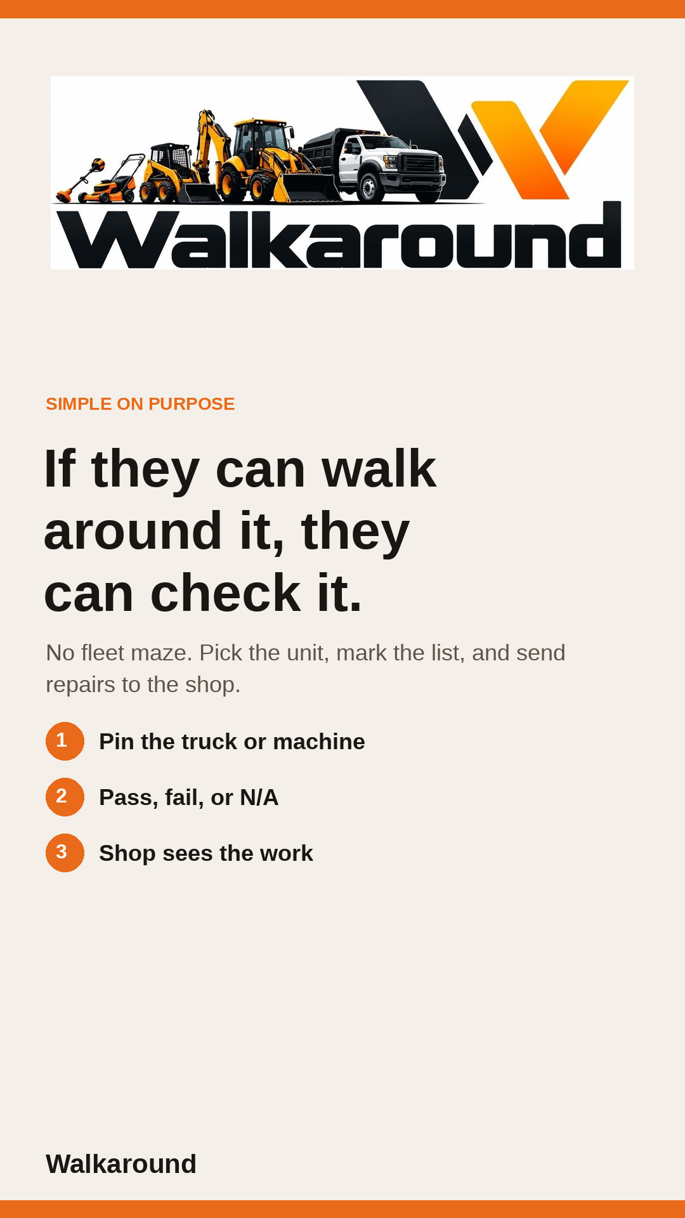
PROMO
Phone story

